Slide 1
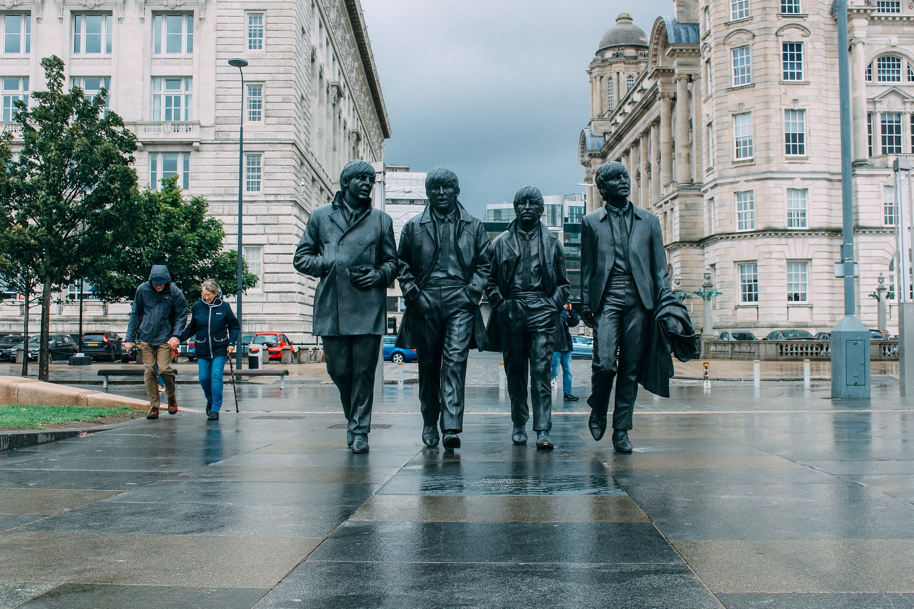

Slide 2
PAUL

Slide 3
GEORGE

Slide 4
Ringo

Slide 5
JOHN

